Slide 1
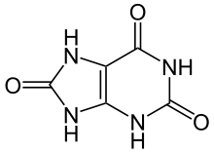
Hyperuricemia: high uric acid aka urate
Uric Acid > 7 mg/dL
Uric acid is excreted renally (has no function).
Cause of Hyperuricemia (CAN’T LEAP)
Cyclosporine
Alcohol
Niacin: Vitamin B3
Thiazides
Levodopa
Ethambutol (TB)
ASA
Pyrazinamide (TB), Purine foods
Uric Acid

Slide 2
Tx of Hyperuricemia
Goal Uric Acid < 6 mg/dL
Who to Tx:
Pts with S/S (gout attacks)
Pts with tophi
Pts with nephrolithiasis (stones)
Pts with nephropathy
 | Allopurinol | Probenecid
MOA | Next slide | Inhibits uric acid reabsorption
Dose | Start 100 mg daily If CKD 50 mg daily + 10 glasses of water | 250 mg BID + 10 glasses
Titrate | Q2-5 weeks | Q1-2 weeks
Max | 300 mg | 3 grams
Screening | HLA-B*5801 | CI if ClCr < 50
Monitor | SCr Uric Acid Skin rxn | Uric Acid
D-D | Next slide | Penicillin (good)
Notes:
Probenecid inhibits renal reabsorption. That’s why it’s Contraindicated if pt has renal issues

Slide 3
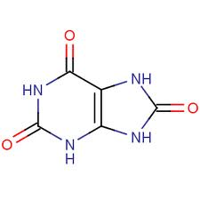
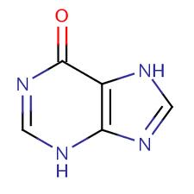
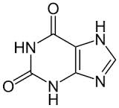
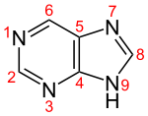
Allopurinol MOA
Inhibits Xanthine Oxidase
Allopurinol
-
-
Xanthine
Oxidase
Xanthine
Oxidase
Excretion
Purine
Hypoxanthine
Xanthine
uric acid
D-D with Allopurinol | Tx | Reason | Avoid by
Mercaptopurine (6-MP) | Immunosuppressive | Inhibits metabolism | 50% allopurinol
Al hydroxide | Antacid | Decrease absorption | Take allopurinol 3 hr before or 6 hr after
Azathioprine | Prodrug of 6-MP | Same as 6-MP
ACE-Inhibitors | BP | Allopurinol hypersensitivity
Cyclophosphamide | cancer | Increases cyclo

